Slide 1
CIS2303-SysTEMS ANALYSIS and DESIGN
Chapter 6
SYSTEM REQUIREMENTS Documentation- Modelling SYSTEMS’ STRCUTURE
CHAPTER 6 | CLO3: Create structural models to specify system requirements, both independently and in collaboration with peers

Slide 2
Document Revision CONTROL (DRC)
Version | Author | Effective Date | Change Description | DCR No
1.0 | Dr. Nourchene Benayed | June 9, 2020 | Defined the first version | 001
1.1 | Dr. Belsam Attallah | June 16, 2020 | Edited text, and resized and adjusted images | 001
1.2 | Sharmila Siddartha | Dec 22, 2022 | Updated slides 10, 11, 12, 17 | 001
X.Y
X: Major change
Y: minor change

Slide 3
Lecture Notes
Contents of lectures are based on the textbook, recommended text, and supplementary material
Please read Chapter 4 of “Systems Analysis and Design in changing the world” from page 103 to 111

Slide 4
Lecture OUTLINE
KEY TERMS
CORE PROCESS 3 ACTIVITY 2
CLASS DIAGRAM CONCEPTS
CASE STUDY

Slide 5
LECTURE OBJECTIVES
At the end of lecture, the student should be able to:
Describe the concepts of a class diagram
Identify and analyze domain classes needed to define the system structure
Read, interpret, and create a domain model class diagram

Slide 6
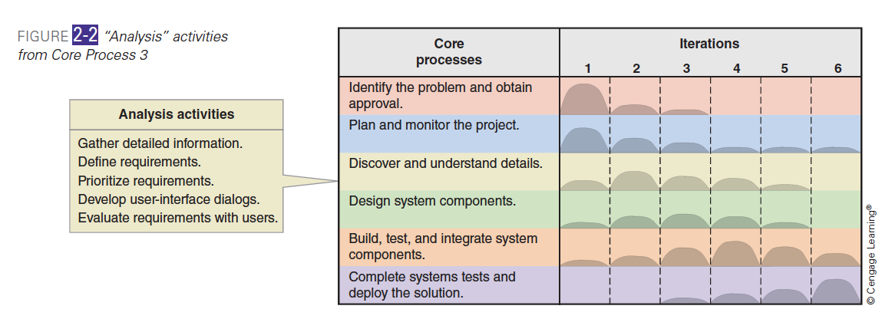
SDLC Core PROCESS 3 and Its ACtivitIeS
Core process 3: Analysis activities
Activity 1: Gather system requirements
Activity 2: Define requirements
Activity 3: Prioritize requirements
Activity 4: Develop user-interface dialogs
Activity 5: Evaluate requirements with users
Notes:
Although we concentrate only on analysis activities in this chapter, keep in
mind that they are usually intermixed with design, implementation, and other
activities during the system development life cycle. For example, as shown in
Figure 2-2, analysis activities are most intensive in the second iteration but occur
in varying degrees during all project iterations except the last.
In this chapter, we are going to cover only activity 2 which is define/or document the requirements

Slide 7
CORE PROCESS 3 Activity 2: Define the requirements
 | Business Process | Functional Requirements | Non-Functional Requirements
Use Case Diagram /Product Backlog |  | X (Chapter 4)
Sequence Diagram |  | X (Chapter 5)
Activity Diagram | X (Chapter 3) | X
Class Diagram |  | X (Chapter 6)
Package Diagram |  | X (Chapter 6)
How to describe the structure of the to-be system?

Slide 8
CORE PROCESS 3 Activity 2: Define the requirements
MODEL THE TO-BE SYSTEM’S STRUCTURE USING UML domain CLASS Diagram

Slide 9
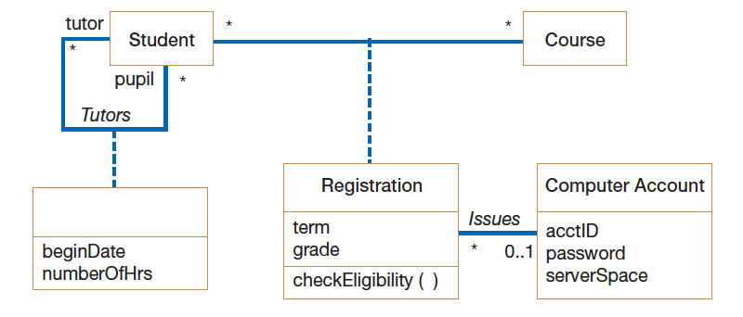
UML CLASS DIAGRAM CONCEPTS
Concepts | Description
Domain Class Diagram | Models the conceptual requirements of the TO BE system during the analysis phase
Class | Represent a collection of objects sharing the same structure, behaviors, relationships, and semantics
Relationships | Represent a link between or among classes
Notes:
Main goal: to discover the key data contained in the problem domain and to build a structural model of the objects

Slide 10
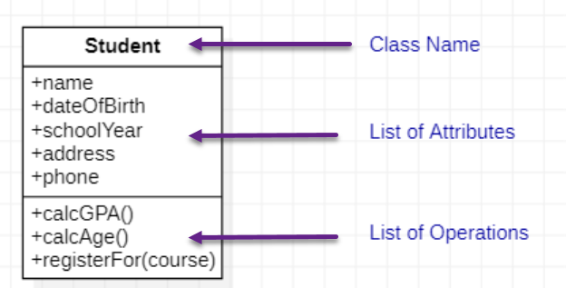
CLASS
A class is a description of a collection of objects sharing the same structure (attributes), behaviors(operations), relationships, and semantics
Attributes are properties describing the state of an instance of class (an object)
Operations are actions or functions that a class can perform
Naming conventions for class names are singular words without spaces. Where more than one word is used, each word is capitalized.

Slide 11
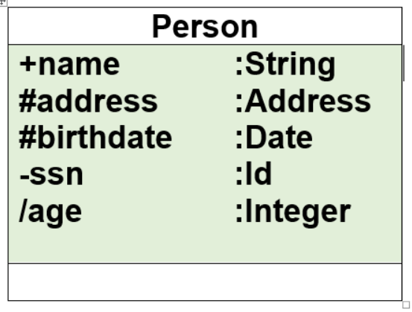
CLASS AtTributes
Attributes are usually listed in the form:
Access_modifier attribute_Name : Type
The access modifiers are :
Public attributes (+): visible to all classes
Protected attributes (#): visible only to an instance of the class in which they are defined and its descendants (sub classes)
Private attributes (-): visible only to an instance of the class in which they are defined
The attribute can be a derived one, which means it can be computed from other attributes
A derived attribute is designated by a preceding ‘/’ as in: / age : Integer
Naming conventions for attributes are singular words without spaces. These are usually nouns.
Notes:
Access modifier restricts access to attributes to ensure consistency
Primary Key and Foreign keys are DB concepts and should not be included in the class diagram. A class has only members and member functions.

Slide 12
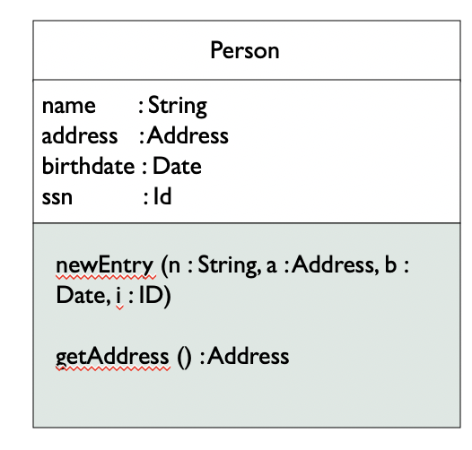
CLASS OPERATIONS
Operations are usually listed in the form:
Access_modifier Operation_Name(Parameter1_Name:type,…, ParameterN_Name:type) : Type
Types of operations:
Constructor—creates an object
Query—makes information about the state of an object available
Update—changes values of some or all object’s attributes
Destructor—deletes or removes an object
Common operations are not shown
Create or delete an instance
Return or set a value
Naming conventions: Operation names are singular words without spaces. Where more than one word is used, each word is capitalized. Operations are verbs
Notes:
Access modifier restricts access to operations to ensure consistency

Slide 13
Relationship
Relationship Types
Dependency
Generalization/Specialization
Association
Aggregation
Composition
Notes:
Please note that Dependency is out of the scope of this course

Slide 14
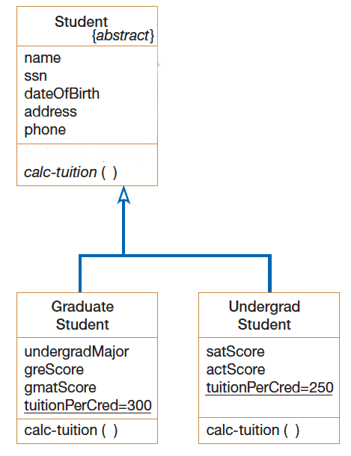
Generalization/Specialization
A generalization connects a subclass to its superclass
It denotes an inheritance of attributes and behavior from the superclass to the subclass
All public and protected attributes and methods of the superclass are inherited by the subclasses
Graduate Student and Undergrad Student are subclasses of Student

Slide 15
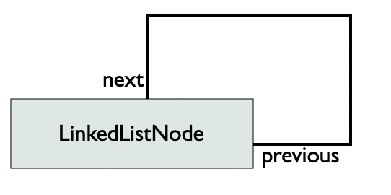
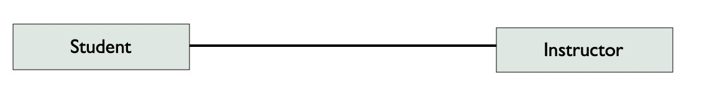
Association…
Binary association means it links 2 classes
Self association means it links the class to itself
Denote a link between classes that need to communicate with each other

Slide 16
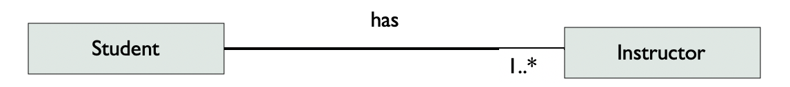
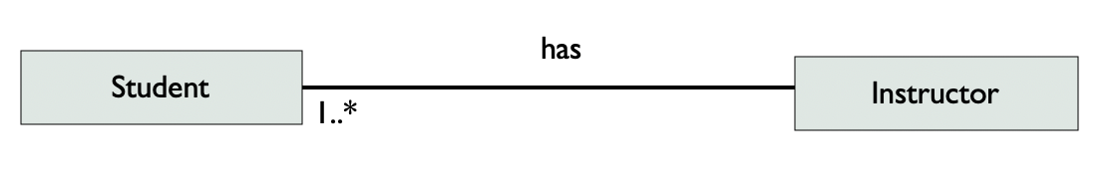
Association
Association has a name and multiplicity indicating how many objects participate in a given relationship
The example indicates that a Student has one or more Instructors:
The example indicates that every Instructor has one or more Students:

Slide 17
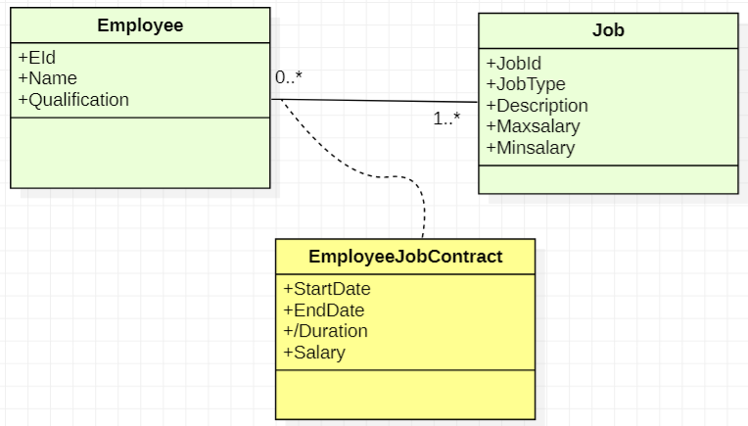
AssociatiVE CLASS
Associative class: An association that has attributes or operations of its own or that participates in relationships with other classes.
Example:
An employee works in several jobs and a job is done by several employees over a period of time. We need to record the start date, the end date, and the salary of each employee in each occupied job.
The associative class is the employee job contract having attributes that define details of an employee doing the job for a specific period of time

Slide 18
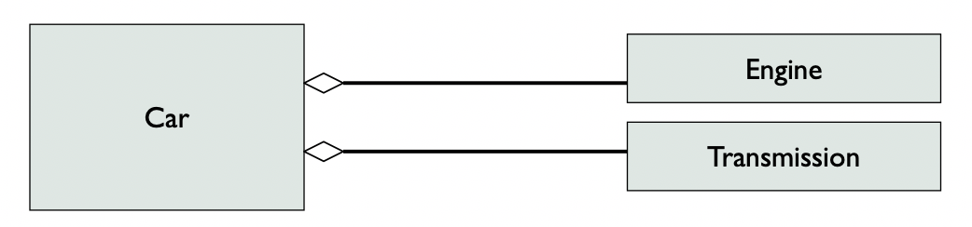
AGGREGATION
An aggregation specifies
A logical whole-part relationship between a whole and a constituent part
Where the part can exist independently from the whole
Aggregations are denoted by a hollow-diamond adornment on the association

Slide 19
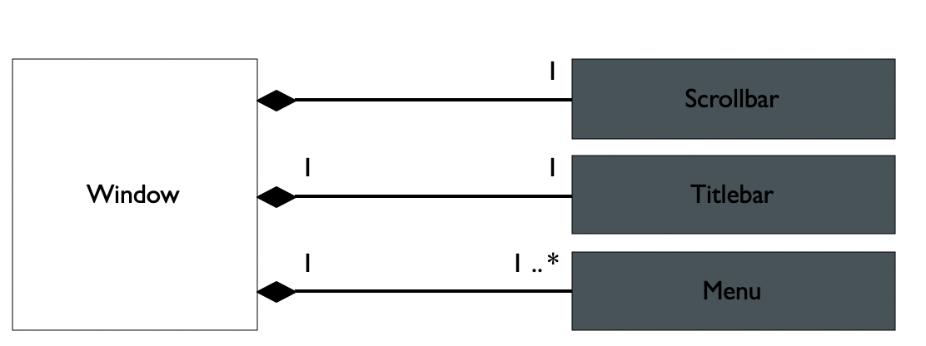
COMPOSITION
A composition indicates
A physical/strong whole-part relationship between a whole and a constituent part
Where the part can’t exist independently from the whole (i.e., they live and die as a whole)
Compositions are denoted by a filled-diamond adornment on the association

Slide 20
When to use aggregation AND Composition?
Association to Aggregation
Rule 1: If the association name is “consists of”, “is composed of” or any synonym, transform the association into aggregation
Aggregation to Composition
Rule 2: Check the multiplicity on the the top of the diamond, if it is 0..n or 1..n then it can’t be transformed into composition, otherwise, if it is (0..1 and 1..1) check Rule 3
Rule 3: if there is a life dependency between the whole and part, then transform it into composition, otherwise keep it as an aggregation

Slide 21
How to create a DOMAIN CLASS Diagram?
Proceed to a lexical and linguistic analysis of the case study description
Nouns are potential classes
Verbs are potential associations
Determiners and plural indicate the multiplicity

Slide 22

Case study
FLIGHT BOOKING MANAGEMENT SYSTEM

Slide 23
Case study
The interviews that we had with domain experts enabled us to summarize their knowledge of the field in the form of the following sentences:
1. Airline companies offer various flights.
2. A flight is open to booking and closed again by order of the company.
3. A customer can book one or more flights and for different passengers.
4. A booking concerns a single flight and a single passenger.
5. A booking can be cancelled or confirmed.
6. A flight has a departure airport and an arrival airport.
7. A flight has a departure day and time, and an arrival day and time.
8. A flight may involve stopovers in airports.
9. A stopover has an arrival time and a departure time.
10. Each airport serves one or more cities.
a simplified flight booking system

Slide 24
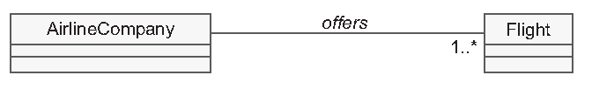
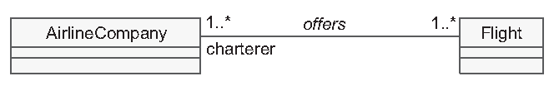
Sentence 1
1. Airline companies offer various flights.
AirlineCompany and Flight are important concepts of the real world;
They have properties and behaviors. They are therefore candidate classes for our static modeling
The sentence does not give us any indication of the multiplicity to the side of the AirlineCompany class
Notes:
This is the first question we will have to ask the domain expert
We will start from the notion that a flight is offered most often by a single airline company, but that it can also be shared among several charterers

Slide 25
Restaurant
Menu
chef
Custmer
1..*
Application
employee
Order
Type of order

Slide 26
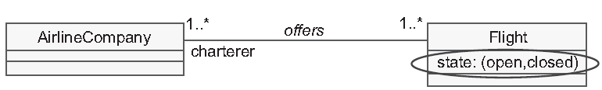
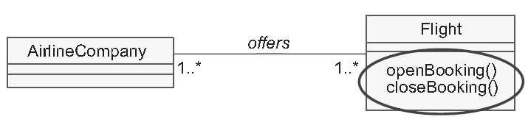
Sentence 2
2. A flight is open to booking and closed again by order of the company
The solution above is wrong
The notions of opening and closing the booking represent dynamic concepts
In the UML class diagram, the only available dynamic concepts are the operations
Error

Slide 27
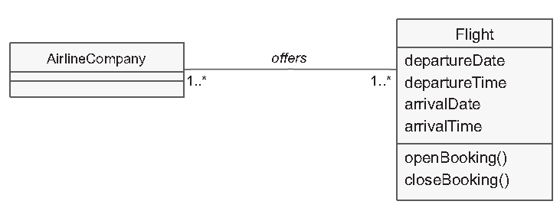
Sentence 7
7. A flight has a departure day and time and an arrival day and time
All these notions of dates and times simply represent pure values
We will therefore model them as attributes and not as fully-fledged objects
Error

Slide 28
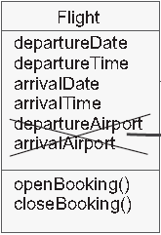
Sentence 6
6. A flight has a departure airport and an arrival airport
Can I consider a departure airport and an arrival airport as attributes?
Unlike the notions of time and date which are “simple” types, the notion of airport is complex; it belongs to the domain
An airport does not only possess a name, it also has a capacity, it serves cities, etc
Error

Slide 29
Sentence 6…
6. A flight has a departure airport and an arrival airport
Can I consider a departure airport and an arrival airport as attributes?
Unlike the notions of time and date which are “simple” types, the notion of airport is complex; it belongs to the domain
An airport does not only possess a name, it also has a capacity, it serves cities, etc
Error

Slide 30

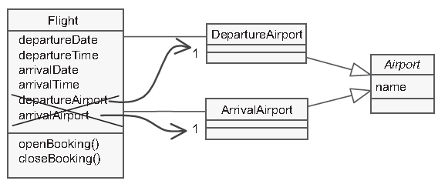
Sentence 6
6. A flight has a departure airport and an arrival airport
What about this solution?
Error
Every airport is the departure airport for certain flights and arrival airport for others successively
DepartureAirport and ArrivalAirport classes have the same redundant instances, which should discourage us from defining two distinct classes

Slide 31
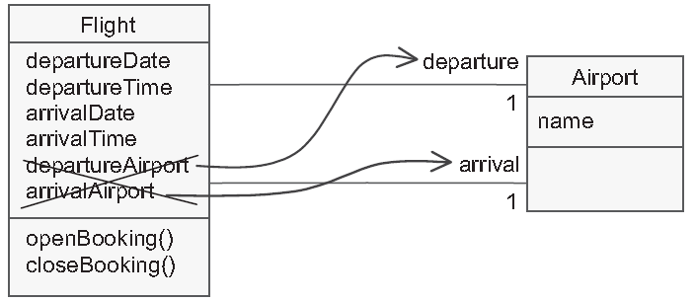
Sentence 6
6. A flight has a departure airport and an arrival airport
What about this solution?
Error

Slide 32
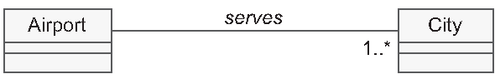
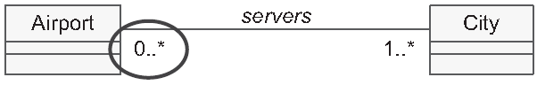
Sentence 10
10. Each airport serves one or more cities
Error
Notes:
However, we notice once again that sentence 10 only concerns one direction of the association. It does not enable the multiplicity to the side of the Airport class to be determined
The question must therefore be formulated in the following way: By how many airports is a city served?

Slide 33
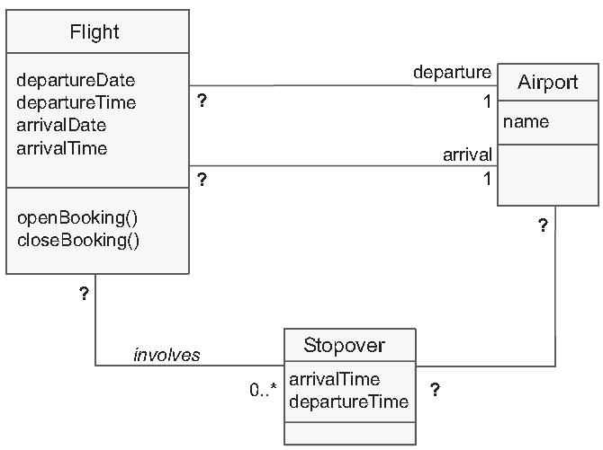
Sentence 8 & 9…
8. A flight may involve stopovers in airports
9. A stopover has an arrival time and a departure time
Every stopover has two properties according to sentence 9: arrival time and departure time
According to sentence 8, it is also in connection with flights and airports, which are themselves objects
It is therefore natural to make a class of it for itself
Sentence 8 is also imprecise: can a stopover belong to several flights, and what are the multiplicities between Stopover and Airport?
Notes:
consult the domain expert to obtain the answer

Slide 34
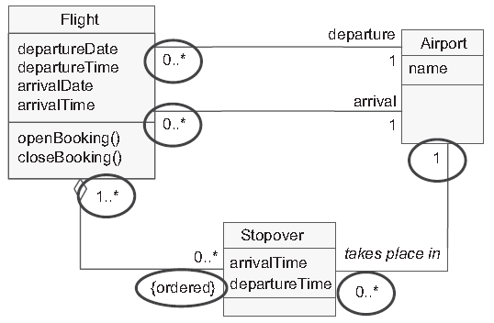
Sentence 8 & 9…
8. A flight may involve stopovers in airports
9. A stopover has an arrival time and a departure time
Aggregation between Flight and Stopover
Stopovers are ordered regarding flight
Solution 1
Notes:
consult the domain expert to obtain the answer

Slide 35
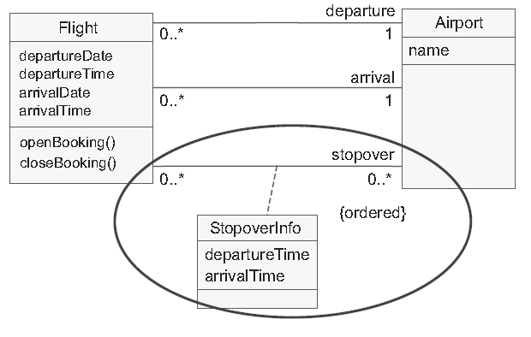
Sentence 8 & 9…
8. A flight may involve stopovers in airports
9. A stopover has an arrival time and a departure time
Notes:
why not consider this notion of stopover as a third role played by an airport with regard to a flight?
The arrivalTime and departureTime attributes then become association attributes
The Stopover class then disappears as such, and finds itself replaced by an association class, StopoverInfo

Slide 36
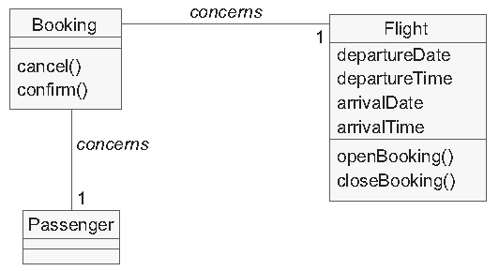
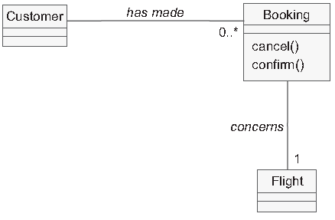
Sentence 3, 4 & 5
3. A customer can book one or more flights and for different passengers
4. A booking concerns a single flight and a single passenger
5. A booking can be cancelled or confirmed
Error

Slide 37
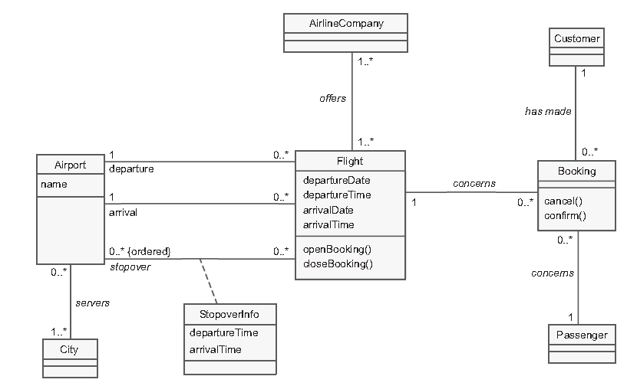
DOMAIN Class Diagram v1

Slide 38
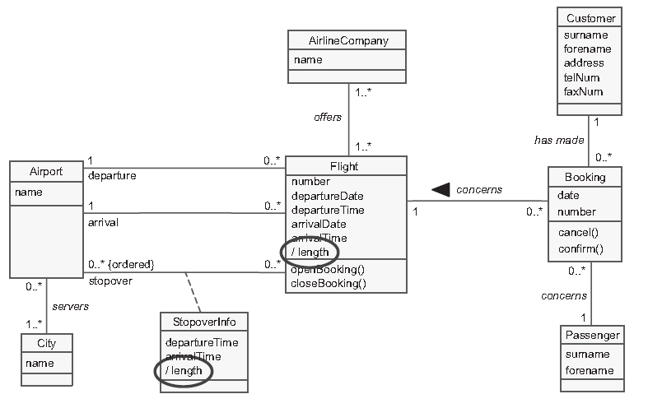




DOMAIN Class Diagram V2
with additional attributes
Notes:
Blue: Classes decribe the flight management
Red: classes decribe the booking management

Slide 39
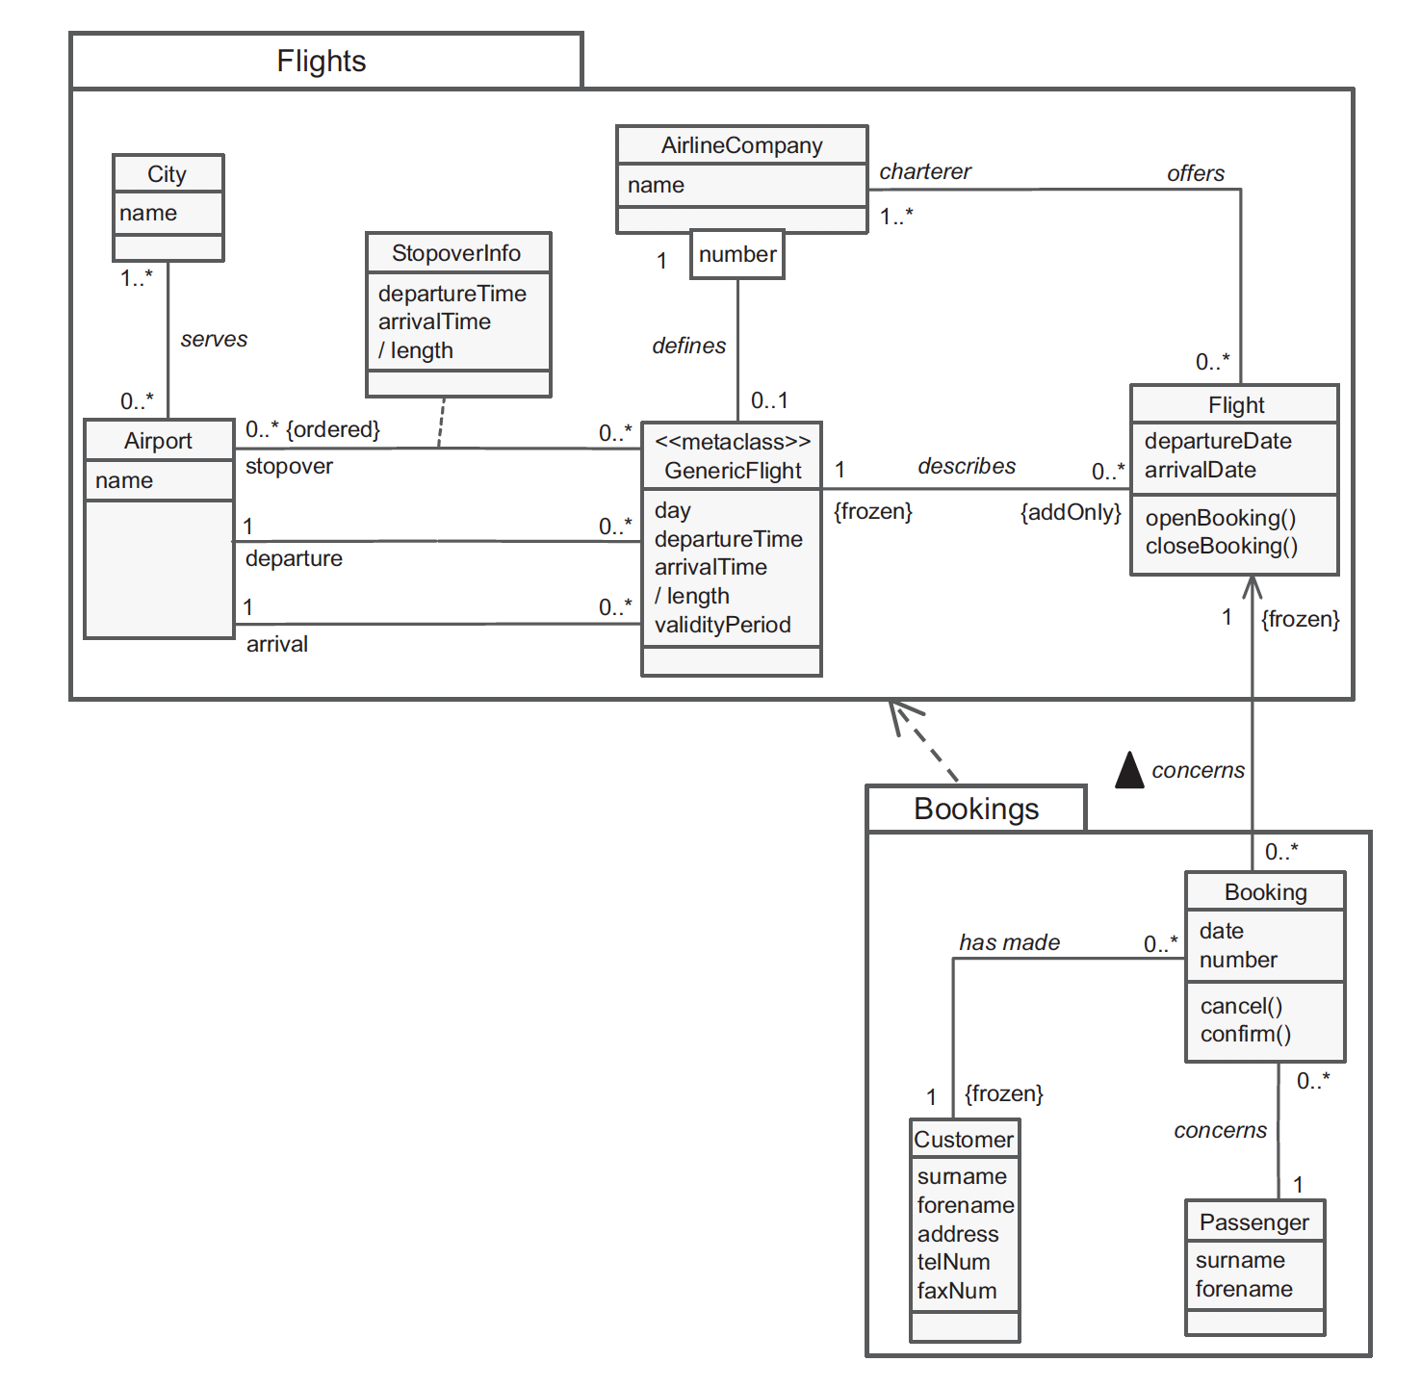
DomaIN Class Diagram FINAL VERSION

Slide 40
KEY TERMS
CORE PROCESS 3: SYSTEM ANALYSIS ACTIVITIES
DOMAIN CLASS DIAGRAM
DESIGN CLASS DIAGRAM
CLASS
ATTRIBUTE
OPERATION
G/S
ASSOCIATION
AGGREGATION
COMPOSITION

Slide 41
Formative assessmentS
Kahoot! CHAPTER6Quiz4
Kahoot! CHAPTER6Quiz5
Notes:
You can find the kahoot!Quiz under the following link: The Higher Colleges of Technology→CIS→Curriculum Development→CIS2303
Please duplicate it in your space and share it with your students.

Slide 42

“Education is not the learning of the facts, but the training of the mind to think.” - Albert Einstein

